Slide 1

Music Genre Classification
Balaji Patakula
Phani Karnati
Saurav Chhatani
P A E Sai Raj
Group 42

Slide 2
Problem Statement
Develop a deep learning algorithm for music genre encoding from raw audio samples without explicit feature engineering
While style is not well-defined for music, the genre piece of music is highly related to its acoustic properties. Current attempts at musical style encoding boast extensive feature engineering and static definitions of components of style. Learning encodings directly from raw audio instead has significant applications in musical style transfer and audio processing.

Slide 3
Prior knowledge & limitations
Extract time and frequency domain features from the audio files.
features are Spectrograms, Mel-spectrograms, MFCC, Spectral centroids, Energy, Spectral Roll-off, Spectral Flux, Spectral Entropy, Zero-crossing rate, and Pitch etc.,
Use any of these features (or ensemble) and training dataset to develop classification models for music genre
Feature engineering is quite cumbersome to achieve more accurate models

Slide 4
Research Scope
Develop autoencoders to learn the latent space without the need for feature extraction.
Optimize the latent vector dimension to enable loss less reconstruction
Use latent vectors as feature set for developing classification models.
Use fully connected convolutional deep neural network to generate the output layer by using the latent vectors as input layer for the training dataset
Use soft max activation function to normalize the output for prediction

Slide 5
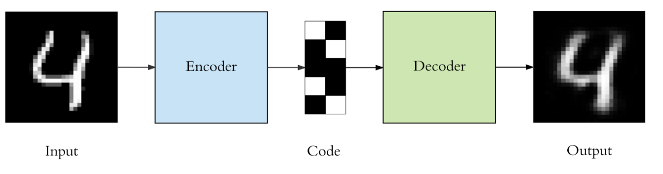
Auto encoders
Dimensionality reduction technique for non-linear space, like PCA for linear space
Compress the input into a lower-dimensional code and then reconstruct the output from this representation
consists of 3 components: encoder, code and decoder. The encoder compresses the input and produces the code, the decoder then reconstructs the input only using this code

Slide 6


Auto encoders
Experiment with :
Vanilla Autoencoder
Encoder : 3 Hidden Layers
Decoder : 3 Hidden Layers
Deep Softmax Autoencoder
Simultaneously train a deep autoencoder and multi-class classifier using
the 64-dim encoding as input to the classifier

Slide 7
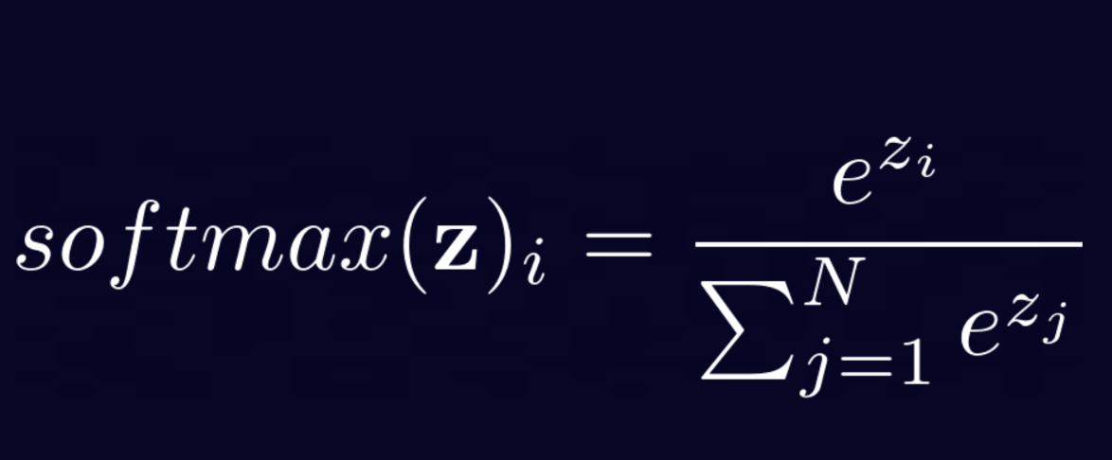
Soft max Activation
Last activation function of a neural network to normalize the output of a network to a probability distribution over predicted output classes.

Slide 8
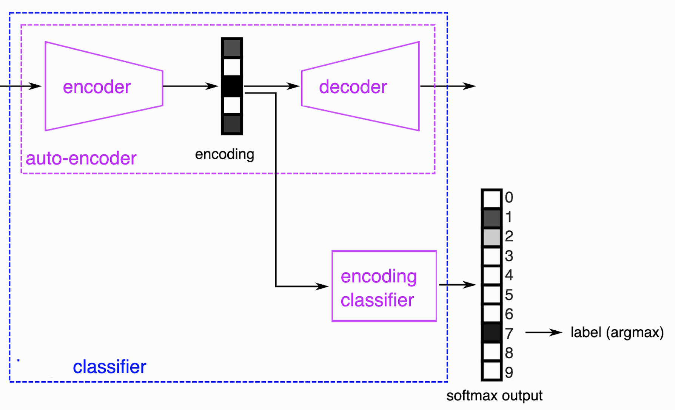

Network Diagram
Input
Output

Slide 9
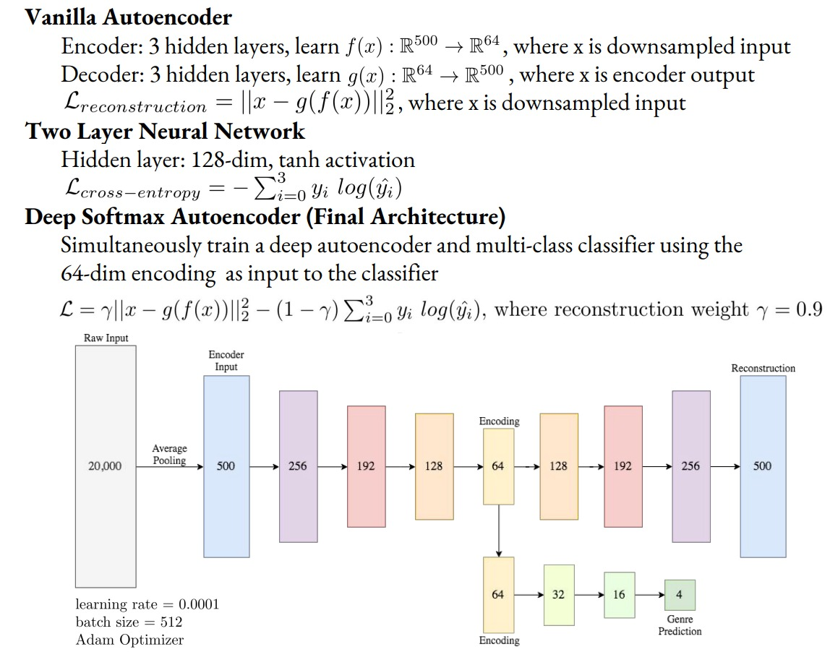
Model Architecture
Output

Slide 10
Dataset
Music Analysis, Retrieval and Synthesis for Audio Signals (MARSYAS) GTZAN Dataset
400 songs (30 seconds each) labelled as classical, jazz, metal, and pop
https://www.kaggle.com/datasets/andradaolteanu/gtzan-dataset-music-genre-classification
Output

Slide 11
Expected Deliveries
Code published: Github Link
Results tabulated: Precision, Recall and F1 scores updated for the training split dataset under the same GitHub project
Deadline:
November 24th - Initial Implementation
November 30th - Verification and Evaluation of Metrics
December 10th - Submission
Output

Slide 12
References
Latent Feature Extraction for Musical Genres https://cs229.stanford.edu/proj2018/report/20.pdf : Click Here
Output

Slide 13


